Slide 2


Library Management System
Object Oriented Programming in C++
Date:25/10/2024
(OEUN VICHHEKA)
OEUN VICHHEKA

Slide 3

Let’s me introduced myself

Slide 4
Library Management System
Description
In this case, I want to introduce our my Book App to our gentleman. This book app can help you to read the book easier and freedom to read it. Nowadays,Mobile phone are everywhere and we can bought it anytime and any product brand name of the phone too.
FT SD M 16 – Library Management System

Slide 5
Library Management Project
UserAccount
Register User
Login User
UserAdd-On Book
Add-On Book
Remove Book
User Management
Input
Add or Remove Book
Exit Program

Slide 6
Library Management System
Pitch
In three sentences max, pitch your application.
The Application easy to use
Decrease our storage of application
Easy to Developer Maintain
The things that someone like to use it because my app easy to use it our open and free to use it. I would introduce my app to our student obviously and adult too if them like it. My book app can help them by knowing our knowledge in their career known a lot of English word too.
FT SD M 16–Library Management System

Slide 7
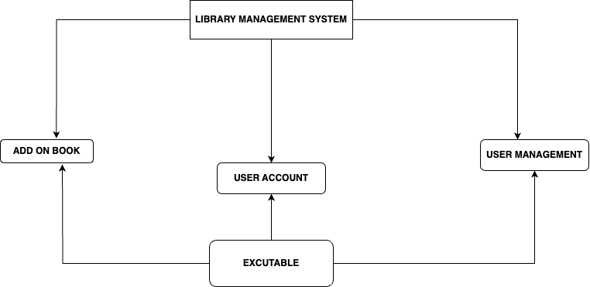
UML Architecture

Slide 8
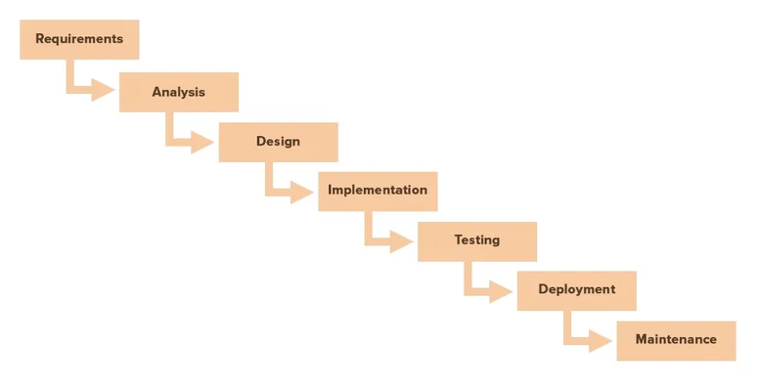
Project Methodology
Description
very briefly describe what your application will implement.

Slide 9
Project Technologies and Tools
Language
C++
Tools
-Visaul Code
-Git & Github

Slide 10
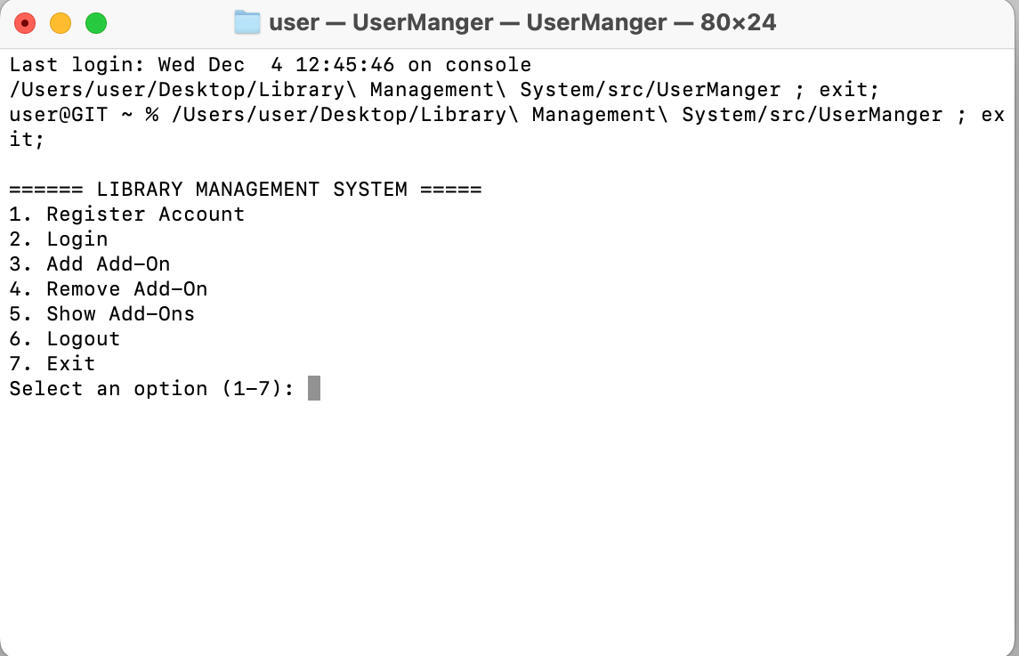
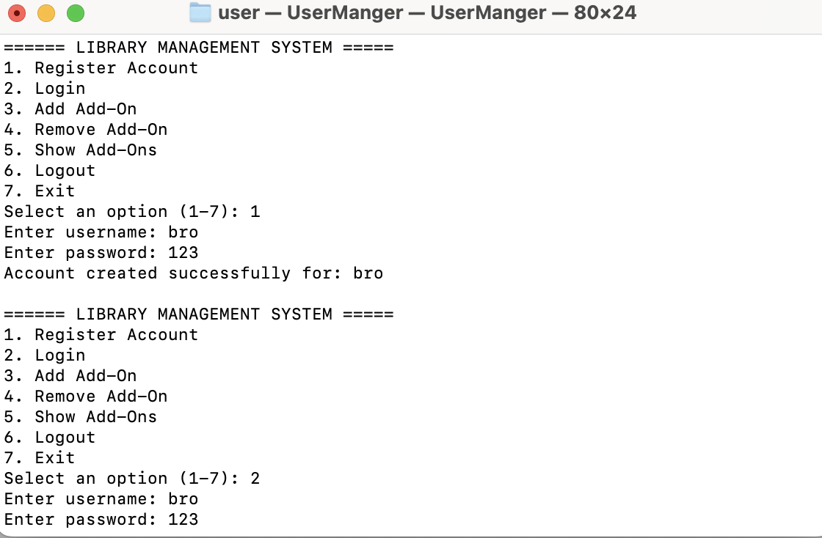
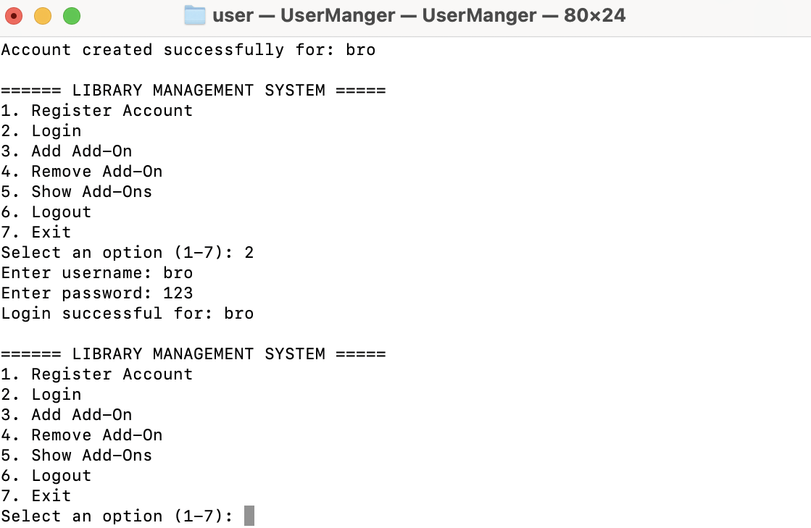
Logical Design or Database Design
Delete this text box and use this slide to visually show what the 1st two screens of your database might look like.
Team Name - Project Name

Slide 11
ABOUT Programming

Slide 12
Future Plans
More Features
Needed to implements the GUI
Organise the code
Management the code more
Clean the code for more
Add more item in the future

